Slide 1
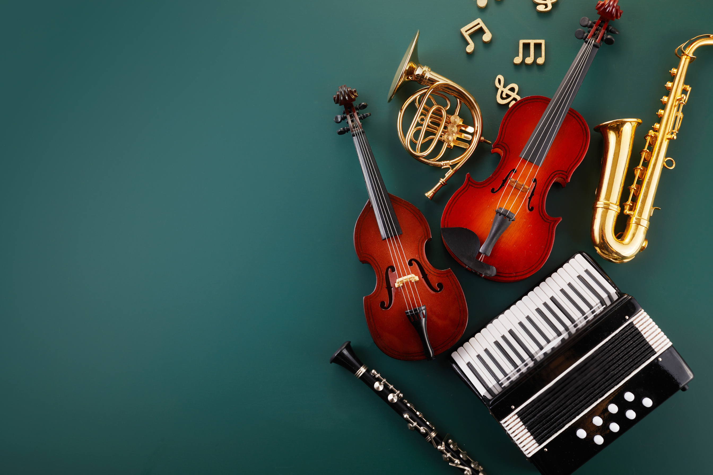


UNT
Music GenrE
Classification
Start Slide

Slide 2

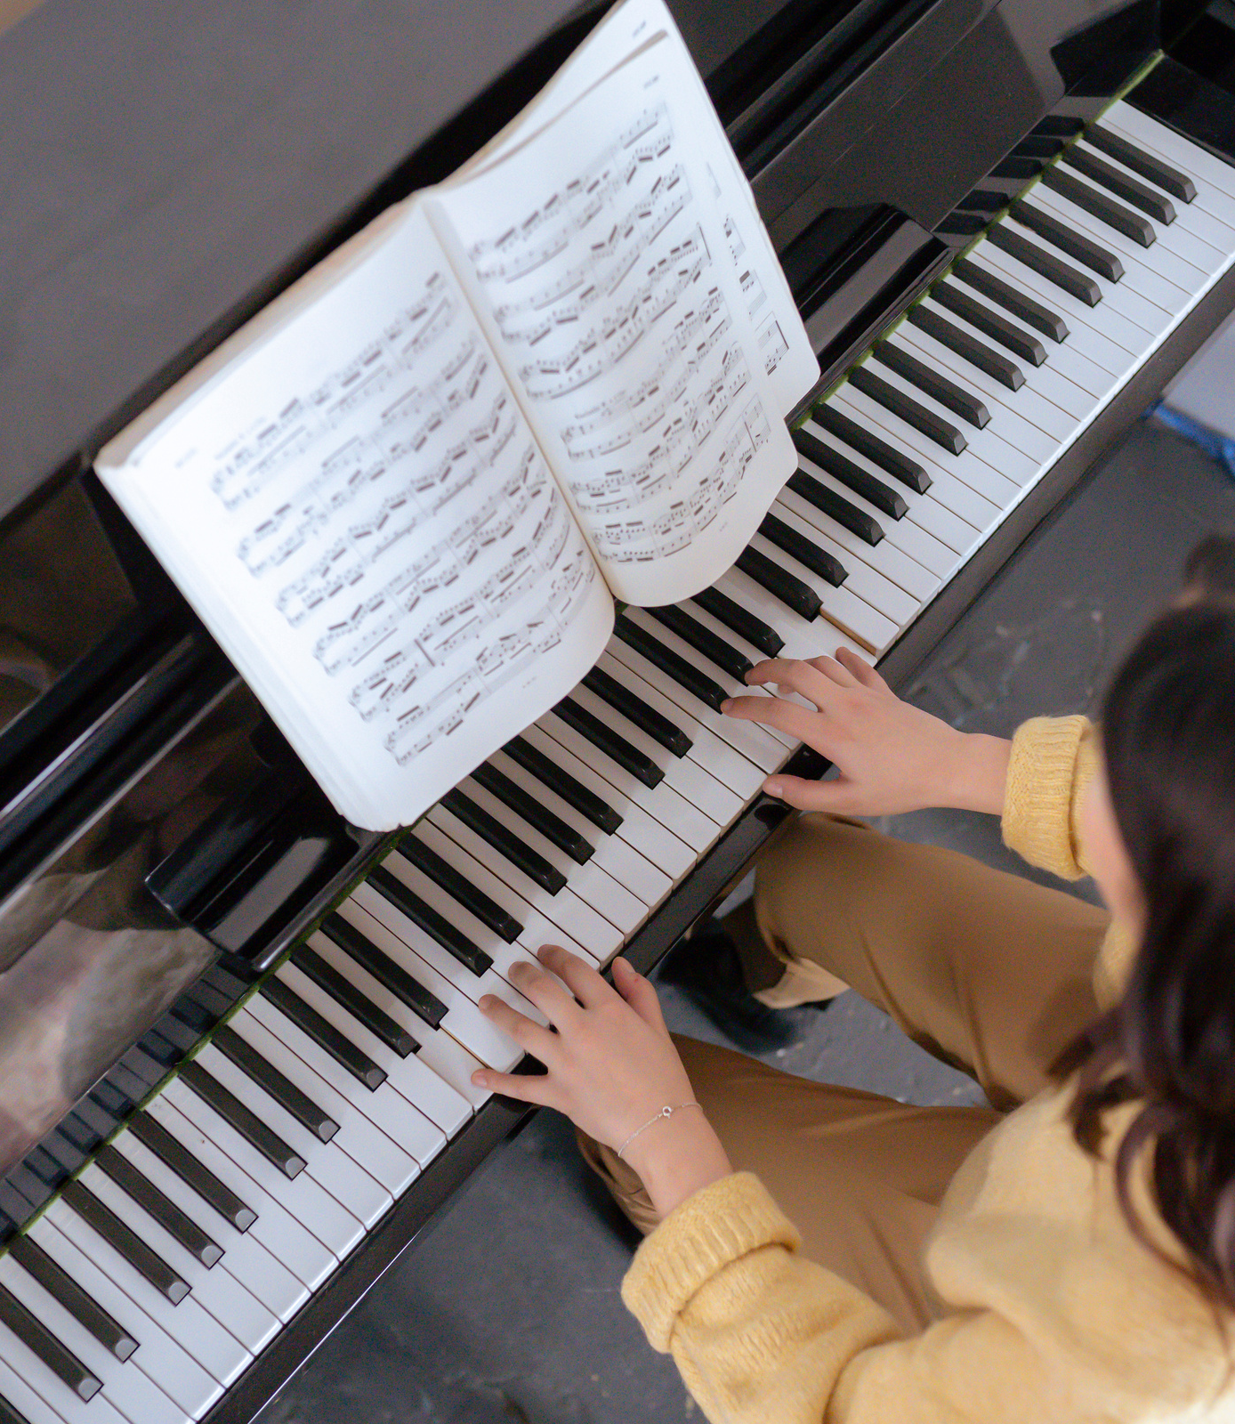

UNT
Introduction
Audio genre classification is the task of automatically recognizing the genre of music.
Used in music recommendation systems, metadata tagging, and music organization.
Our project implements both traditional deep learning and transformer-based approaches.
Next Slide

Slide 3


Motivation
UNT
Manual genre classification is often time-consuming, inconsistent, and subjective.
With the exponential growth of digital music, there's a pressing need for automated, scalable classification solutions.
AI-powered systems can enhance personalization in streaming platforms, improving user experience.
Genre classification also supports music information retrieval, archiving, and metadata generation.
This project leverages both conventional neural networks and state-of-the-art transformers to explore performance trade-offs.

Slide 4
Problem Statement
UNT
The goal of this project is to automatically classify 30-second audio clips into their corresponding music genres from a predefined set of 10 categories.
This involves developing models capable of learning from either handcrafted statistical features or raw audio waveforms.
The challenge lies in capturing both temporal and spectral characteristics of music that distinguish one genre from another.
We aim to evaluate and compare the performance of traditional neural networks and transformer-based models on this task.
Evaluation is based on metrics such as accuracy, F1 score, and model generalization capability.
Next

Slide 5
Methodology
UNT
The project follows a dual-pipeline approach combining traditional deep learning and transformer-based techniques.
Pipeline A (Keras-based):
Load audio features from CSV (MFCCs, tempo, chroma stats).
Normalize, visualize, and reduce dimensionality using PCA.
Train and evaluate multiple dense neural network architectures.
Next

Slide 6
Methodology
UNT
Pipeline B (Transformer-based):
Load raw .wav files and resample them to 16kHz.
Apply wav2vec2 feature extractor and train using Hugging Face Trainer API.
Evaluate using ROC-AUC and classification accuracy.
Final comparison based on model performance, training time, and interpretability.
Next

Slide 7

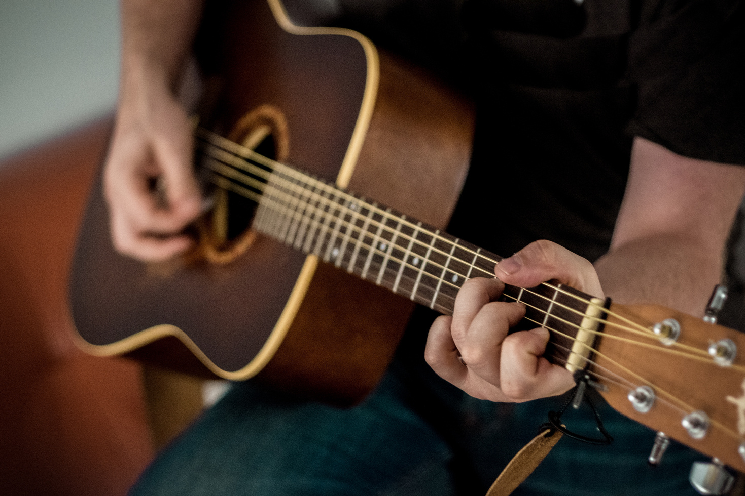
UNT
Dataset Overview
Music
Genre
Dataset: GTZAN Music Genre Dataset
Samples: 9990 audio segments (30 seconds each)
Genres: Blues, Classical, Country, Disco, Hip-Hop, Jazz, Metal, Pop, Reggae, Rock
Classification
Balanced class distribution with minimal preprocessing

Slide 8
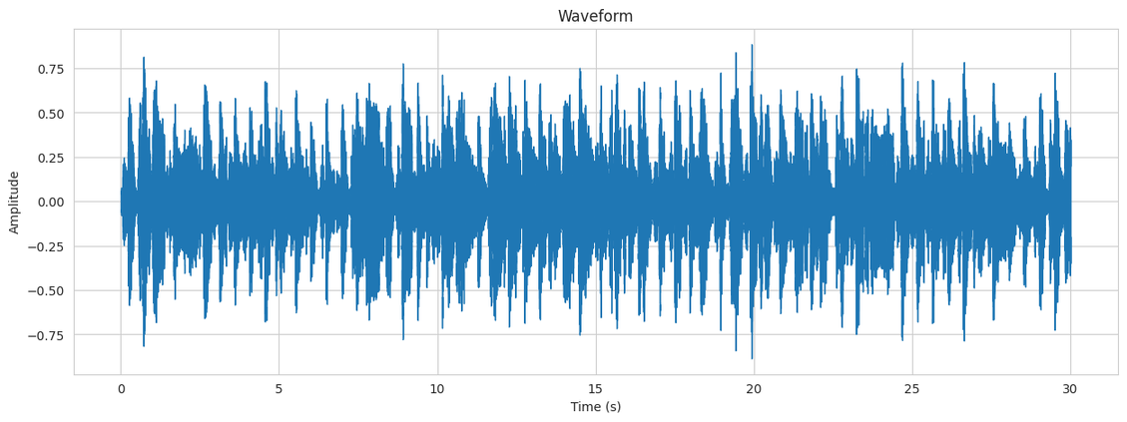

UNT
Audio Preprocessing
The preprocessing stage ensures clean, standardized input for accurate model learning.
Silence Removal: Removed silent sections using librosa.effects.trim to focus on active audio.
Resampling: Standardized all clips to 16kHz to match model input requirements.
Length Normalization: Long clips were truncated; shorter ones were zero-padded.
Time-Frequency Feature Visualizations:
Waveform: Raw amplitude over time
STFT: Frequency variation across time (spectrogram)
Mel Spectrogram: Emphasizes perceptual frequency bands
Chroma Features: Capture harmonic and tonal patterns
Presentations are tools that can be used as lectures, speeches, reports, and more. It is mostly presented like.

Slide 9
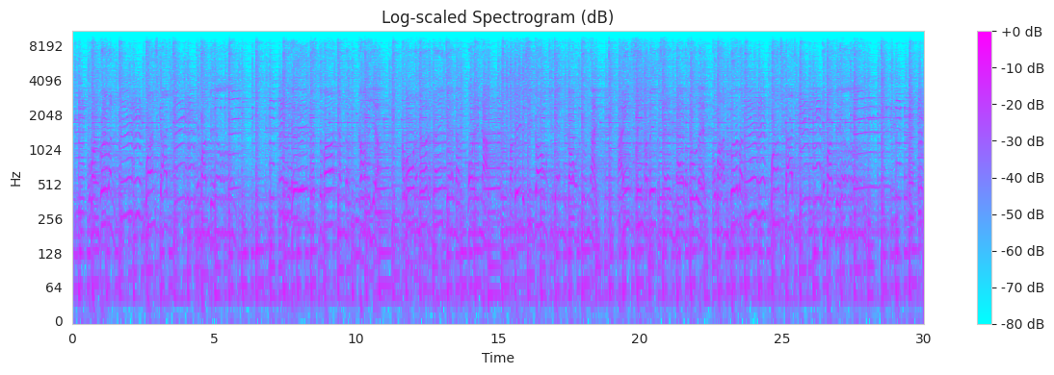
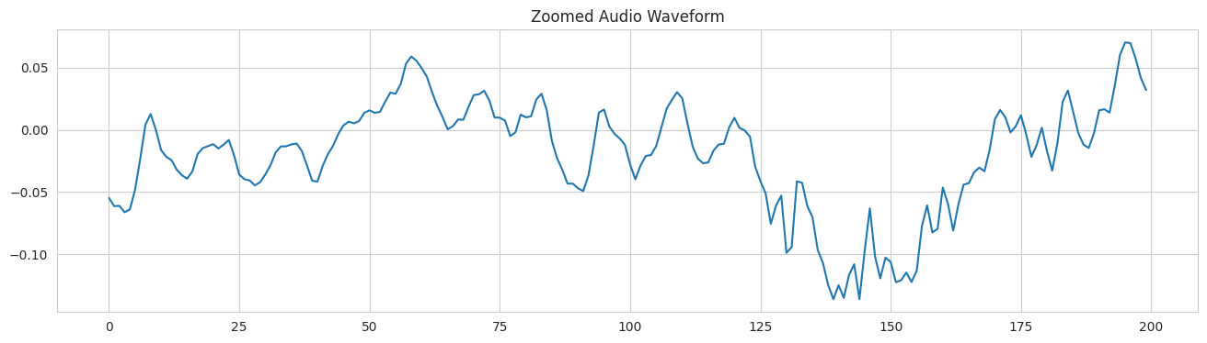

Slide 10
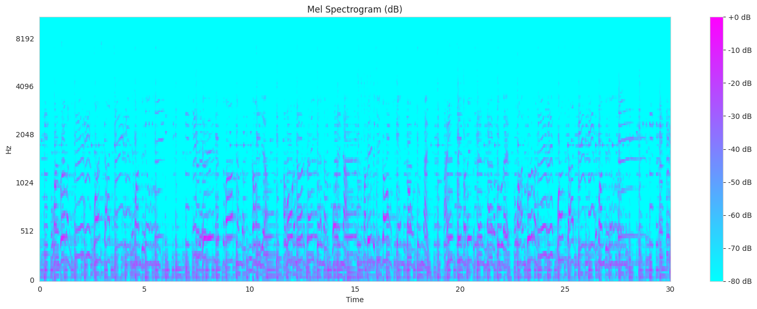
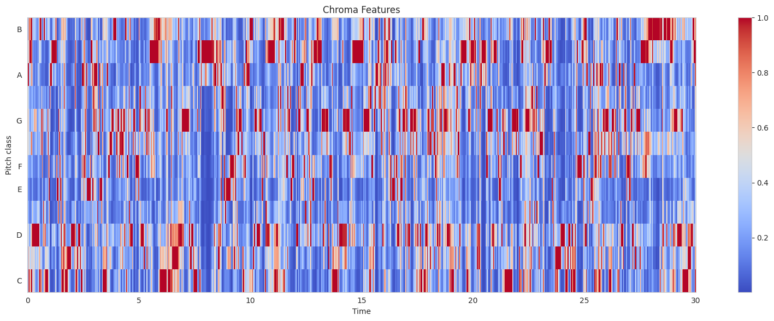

Slide 11
Feature Engineering (Keras Pipeline)
UNT
Extracted statistical features (means, tempo, MFCCs, chroma) from each clip.
Applied StandardScaler for normalization.
Used PCA for dimensionality reduction and visualization.
Enhanced interpretability through correlation heatmaps and genre-wise boxplots.

Slide 12
Deep Learning Models (Keras)
UNT
Model 1: Basic 3-layer MLP (256-128-64 units)
Model 2: Deeper MLP with Dropout layers
Model 3: Same as Model 2 with SGD optimizer
Model 4: 5-layer network with heavy dropout (achieved highest validation accuracy)
Presentations are tools that can be used as lectures, speeches, reports, and more. It is mostly presented like.

Slide 13
Transformer Model (Wav2Vec2)
UNT
Used pretrained Facebook Wav2Vec2-base-960h model.
Input: raw waveforms processed with Hugging Face AutoFeatureExtractor
Fine-tuned using Hugging Face Trainer API.
Training done on balanced and resampled dataset (via RandomOverSampler).

Slide 14



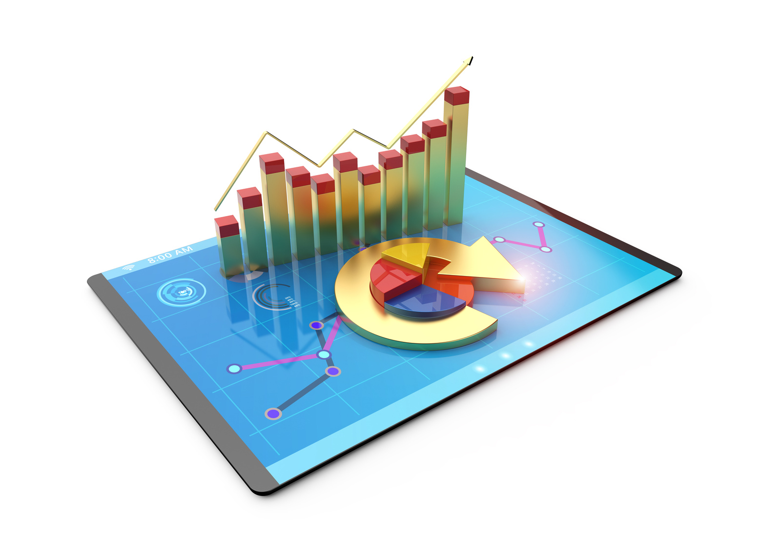
Evaluation – Keras Models
UNT
Validation Accuracy
Test Accuracy:
Macro F1 Score
94.03%
93.42%
93.47%

Slide 15
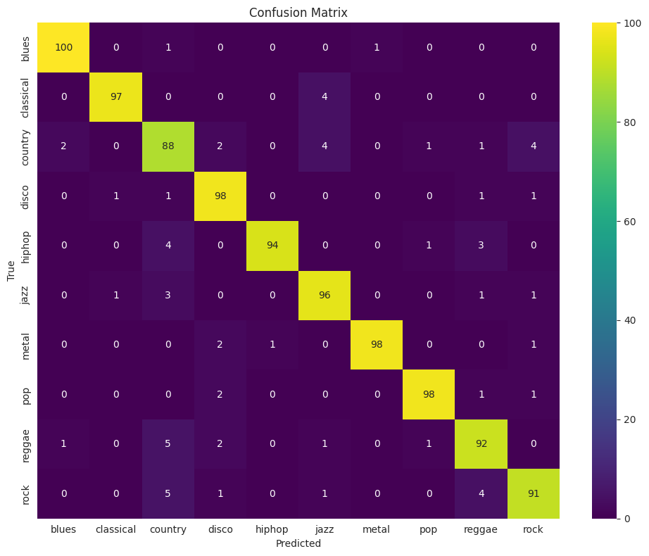

Slide 16
Evaluation – Transformer Model
UNT
Accuracy: 64.5% (Top-1 prediction)
Macro ROC AUC Score: 0.93
Strength: High confidence in predictions across classes
Ideal for real-world probabilistic scoring systems.

Slide 17
Comparative Analysis
Metric/Aspect | Keras MLP | Wav2Vec2 Transformer
Input Type | Engineered Features | Raw Waveform
Accuracy | High (~93%) | Moderate (~65%)
Training Time | Low | High
Interpretability | Easy | Moderate
Real-world Deployment | Lightweight | Resource-intensive

Slide 18
Conclusion
UNT
BUILT COMPLETE PIPELINES USING BOTH STATISTICAL FEATURES AND RAW WAVEFORMS.
KERAS MODELS OUTPERFORMED ON ACCURACY, WHILE TRANSFORMERS EXCELLED IN LEARNING FROM RAW DATA.
PROJECT HIGHLIGHTS THE EVOLUTION OF AUDIO AI AND BRIDGES CLASSICAL ML AND MODERN DL.
SETS THE STAGE FOR MORE ROBUST, SCALABLE MUSIC CLASSIFICATION SYSTEMS.

Slide 19

UNT
Thank
You
for your attention

